Slide 1


Balanced scorecard slide 1
AIR Travel Safety Analysis
Airline Safety Analysis: XYZ Airlines
Sri R Sankaranarayanan DSC640 – Data Visualization Presentation

Slide 2
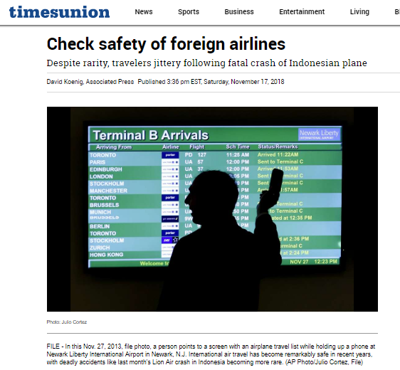
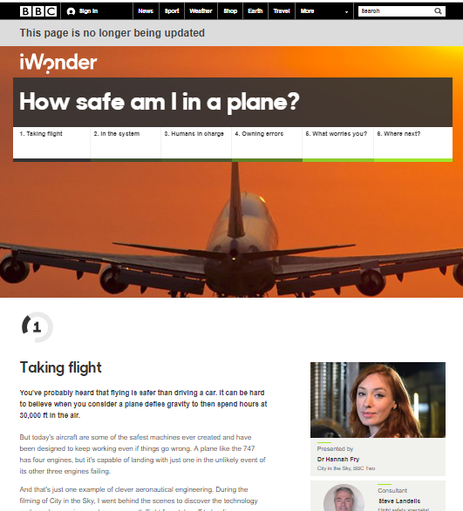
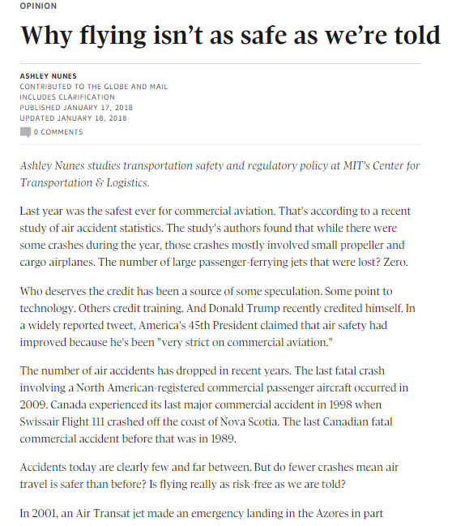
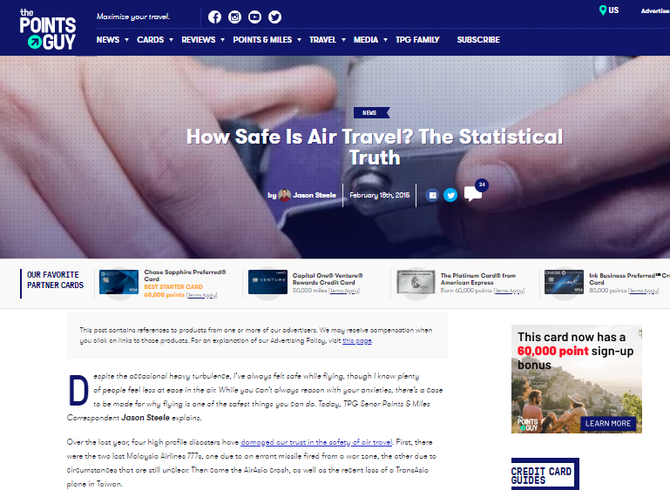
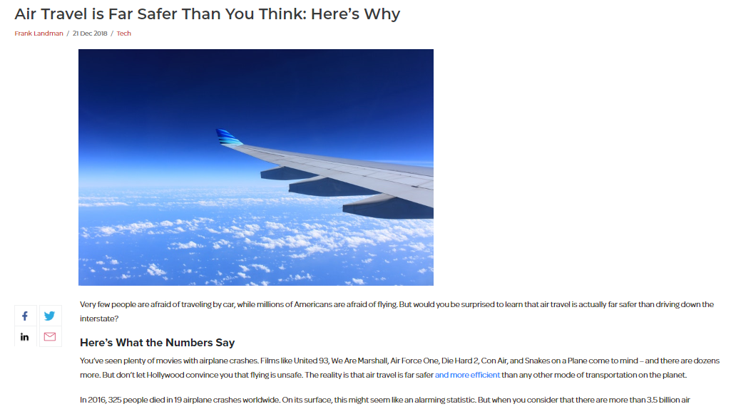
Balanced scorecard slide 2
What does the Newspapers Say about Airline Safety

Slide 3
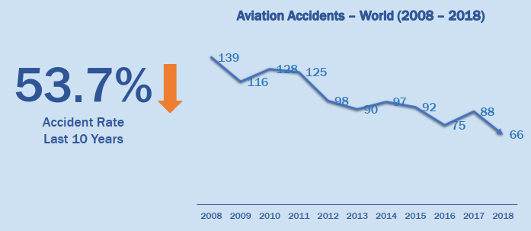
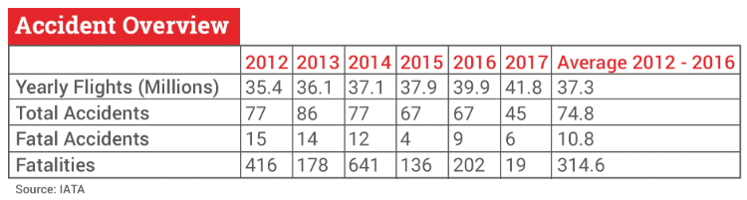
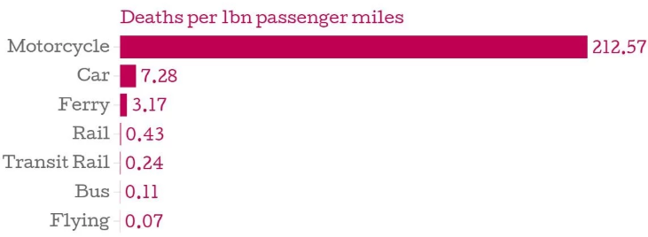
Balanced scorecard slide 4
Statistically Safe

Slide 4
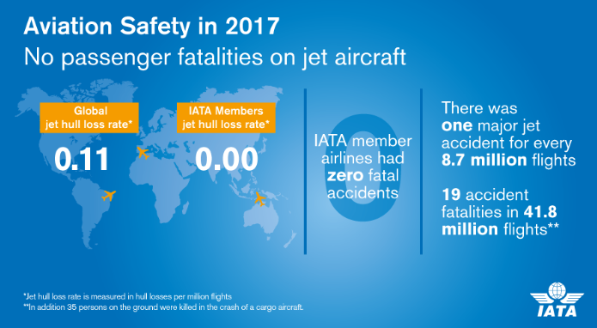

Balanced scorecard slide 3
Why XYZ Airlines is one of the safest

Slide 5
Balanced scorecard slide 3
Summary and Conclusion
My Summary : From the data points collected, the statistics indicates air travel is the safest means of transportation in the modern world. And XYZ airlines is one of the top airlines as far as safety measure is concerned. Therefore, confidently choose XYZ airlines for a safe and reliable travel experience.
THANK YOU

